Slide 1
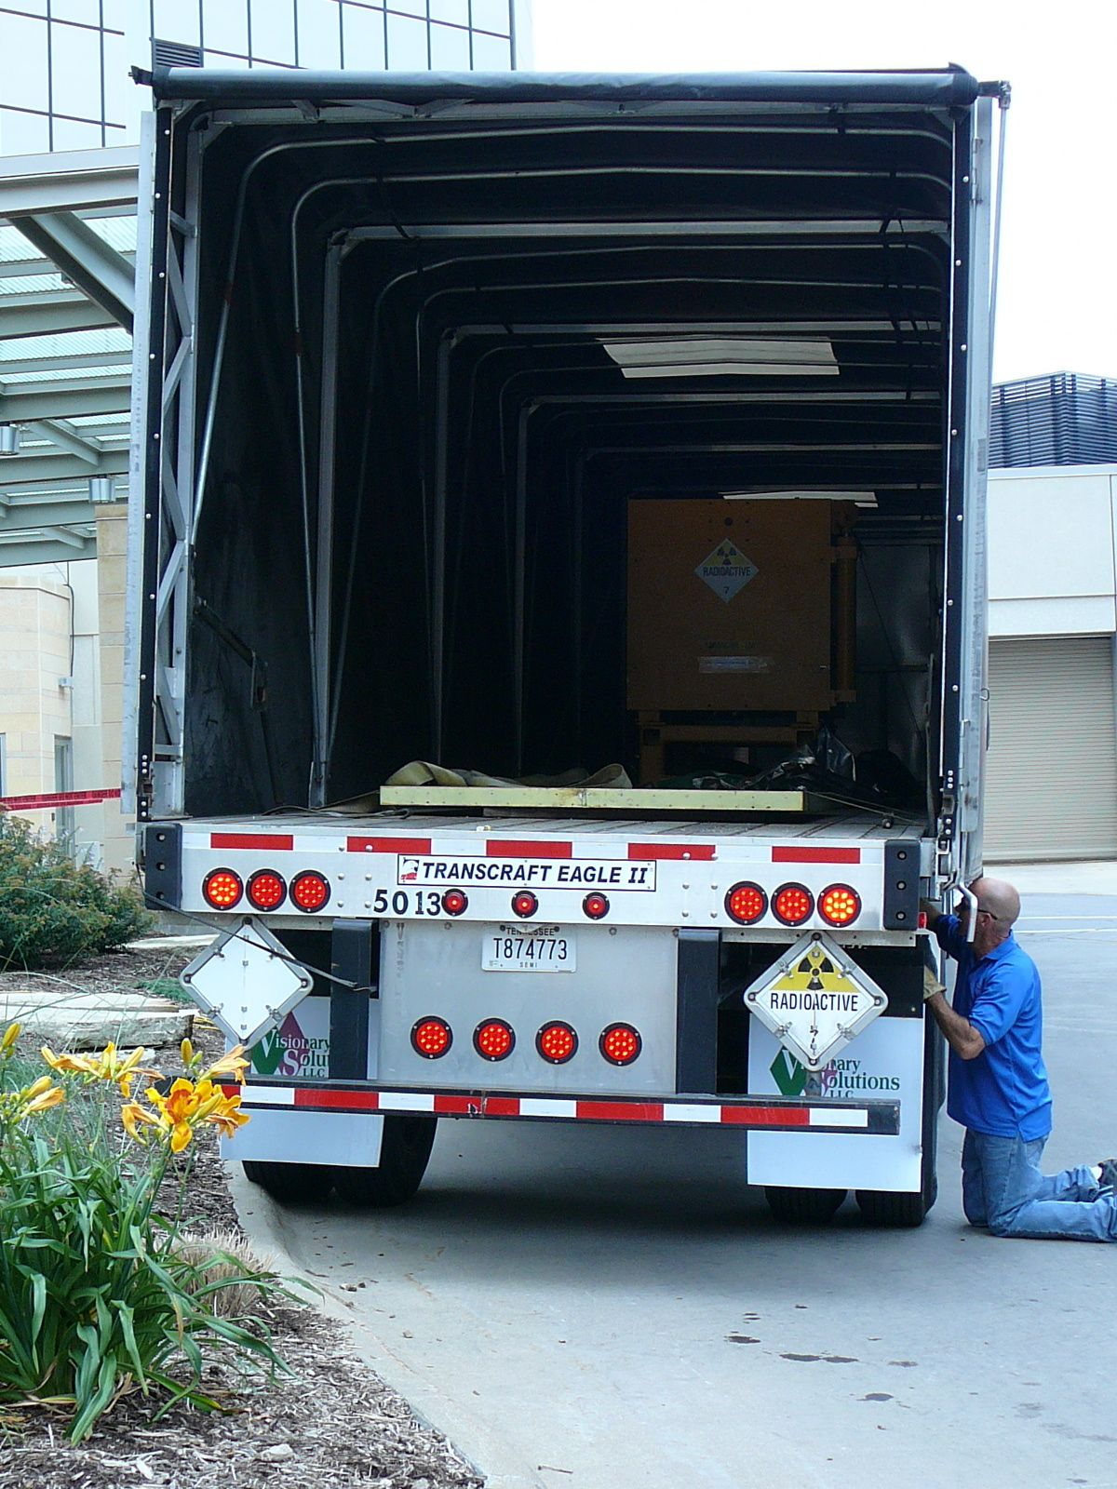
Decommissioning the University of Iowa MC17 Cyclotron
Tom Hansen, CHP, PMP
Ameriphysics, LLC

Slide 2
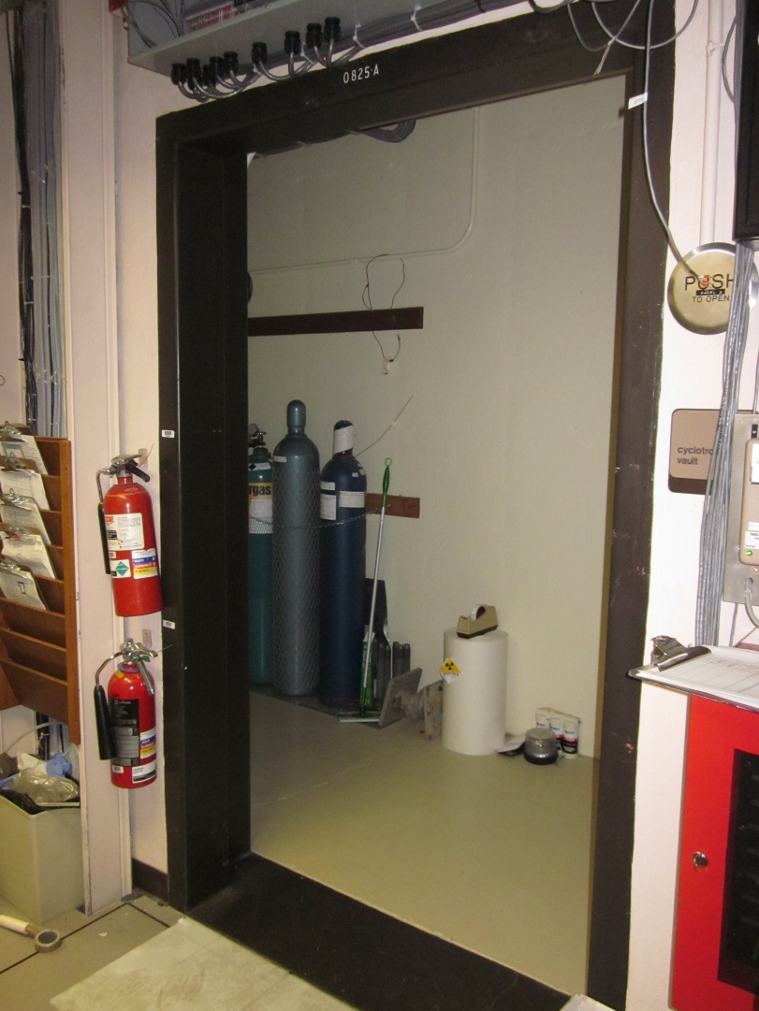
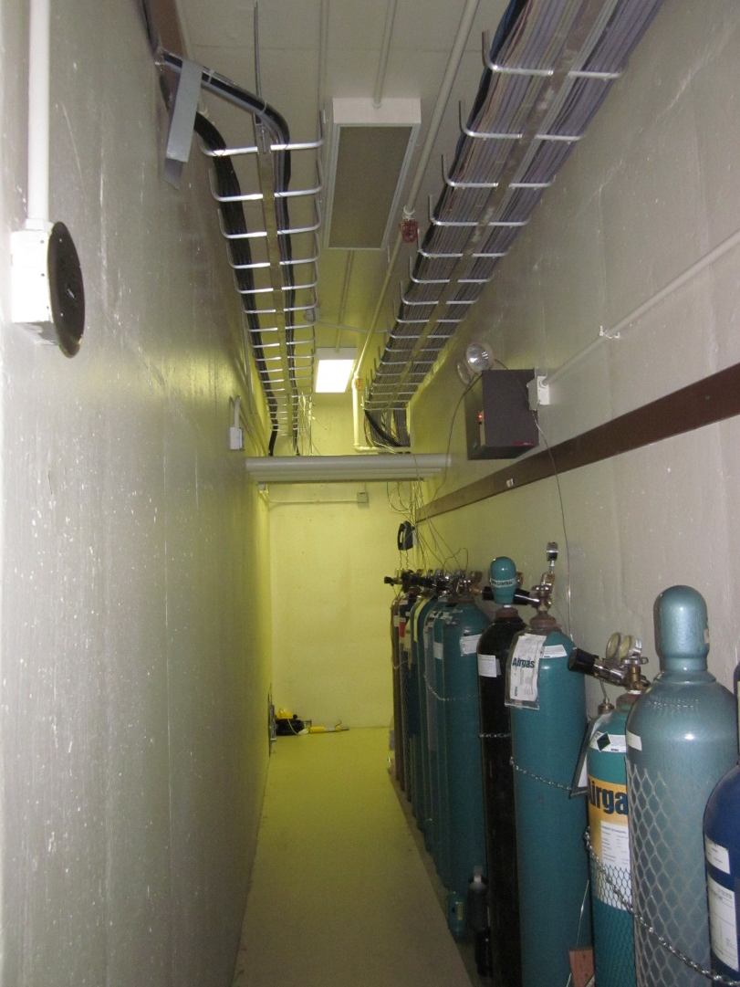
Introduction

Slide 3
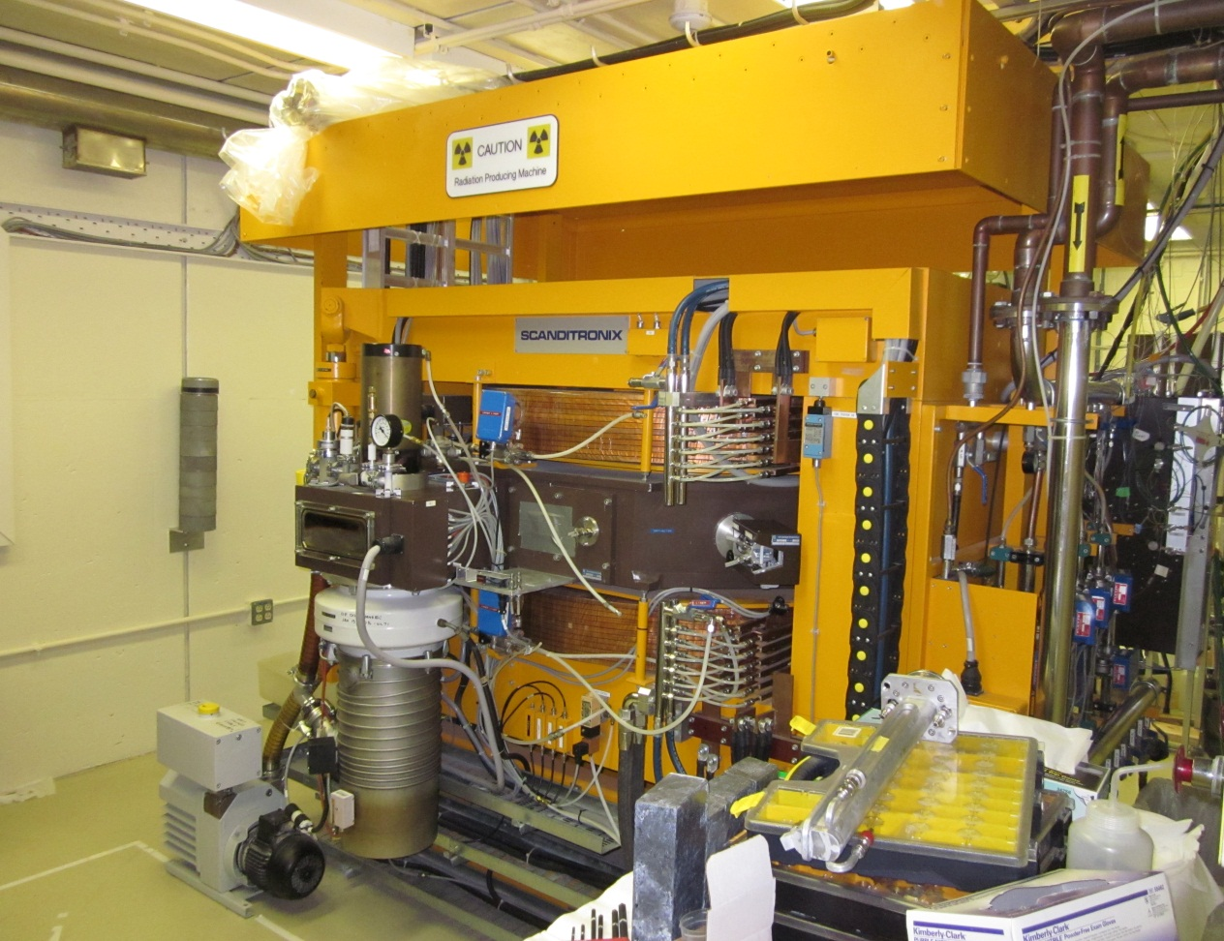
Introduction
Scanditronix MC17 particle accelerator
¹⁸O(p,n)¹⁸F
¹⁴N(d,n)¹⁵O
¹⁴N (p,α)¹¹C
¹⁶O(p,α)¹³N
Operated @ 30 uA, 6 hours/week for last 10 years

Slide 4
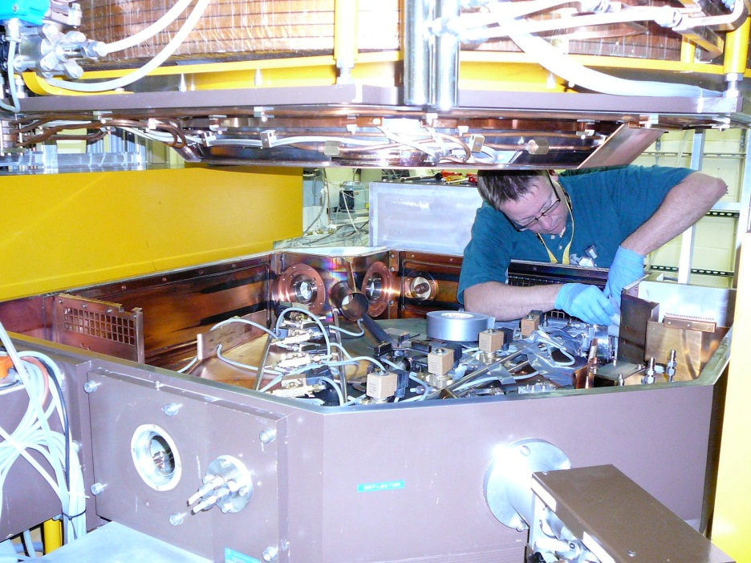
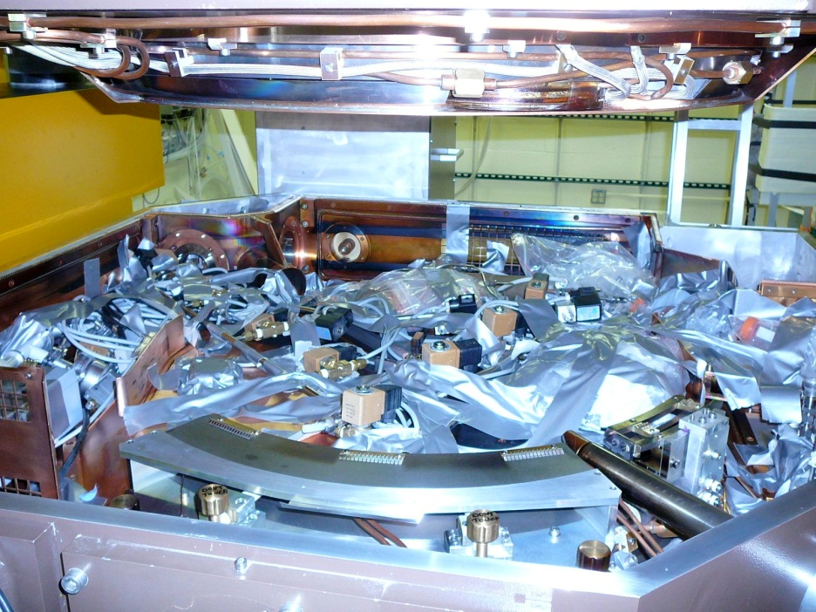
Pre-Characterization

Slide 5
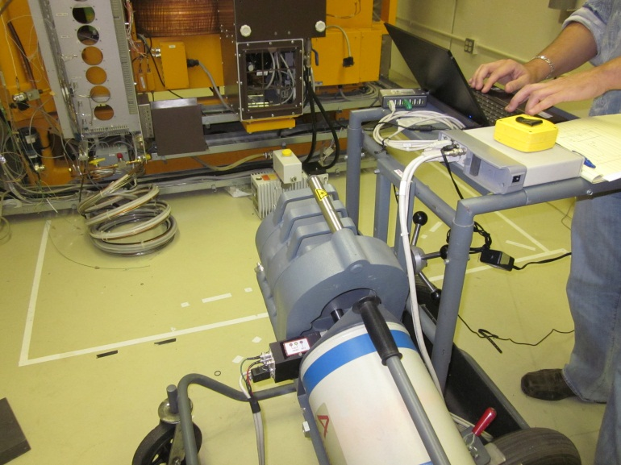
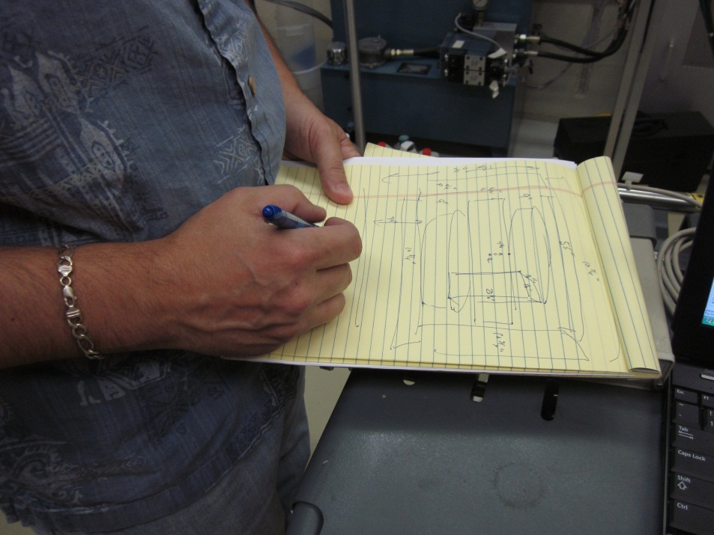
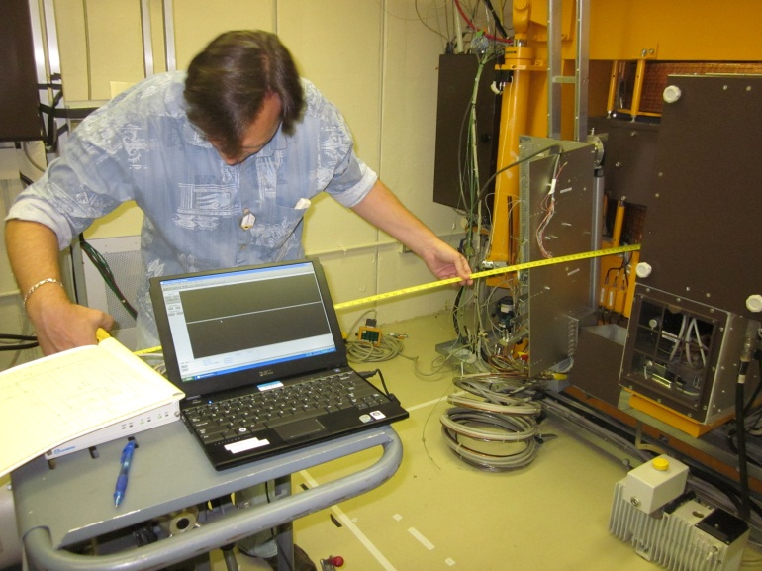
Characterization

Slide 6
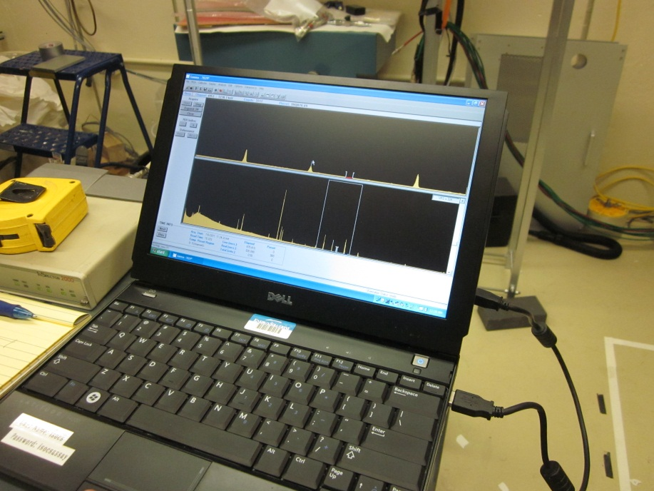
Characterization
Major Activation Products | Primary Source
Be-7 | target material
Na-22 | aluminum, magnesium
Na-24 | aluminum
Sc-48 | titanium
Cr-51 | target material
Mn-52 | target material
Mn-54 | copper, brass
Co-56 | target material
Mn-56 | copper, brass
Co-57 | target material
Ni-57 | nickel
Co-58 | nickel
Fe-59 | iron
Co-60 | copper, concrete
Zn-65 | copper, brass
Sb-124 | alloys in solder and ball bearings
Total Activity: 137 mCi

Slide 7
Characterization

Slide 8
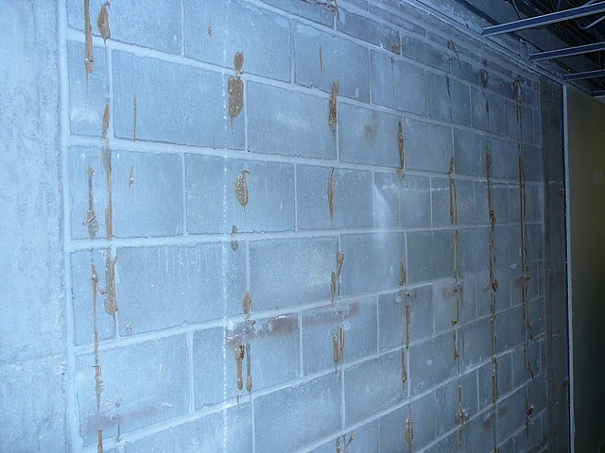
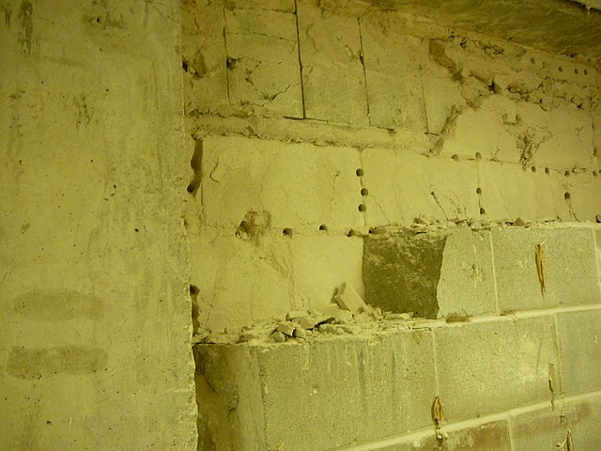
Establish Removal Path

Slide 9
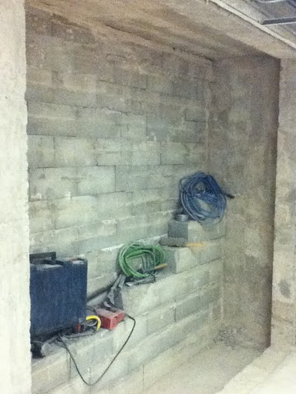
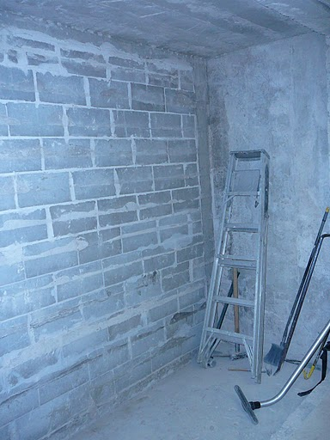
Establish Removal Path

Slide 10
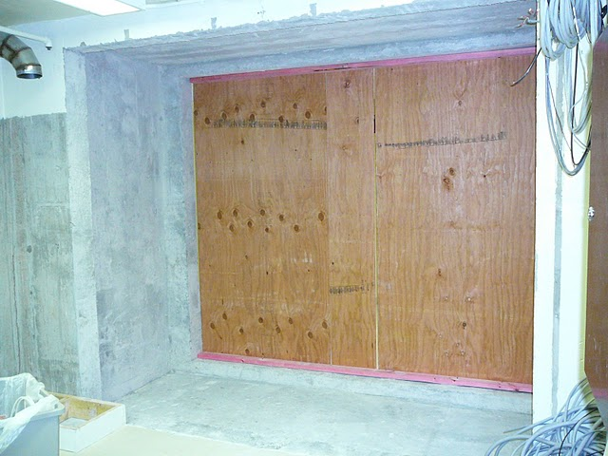
Establish Removal Path

Slide 11
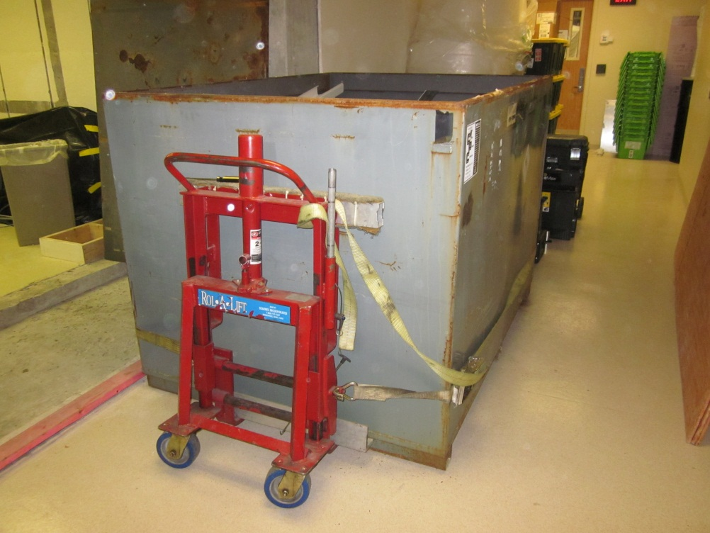
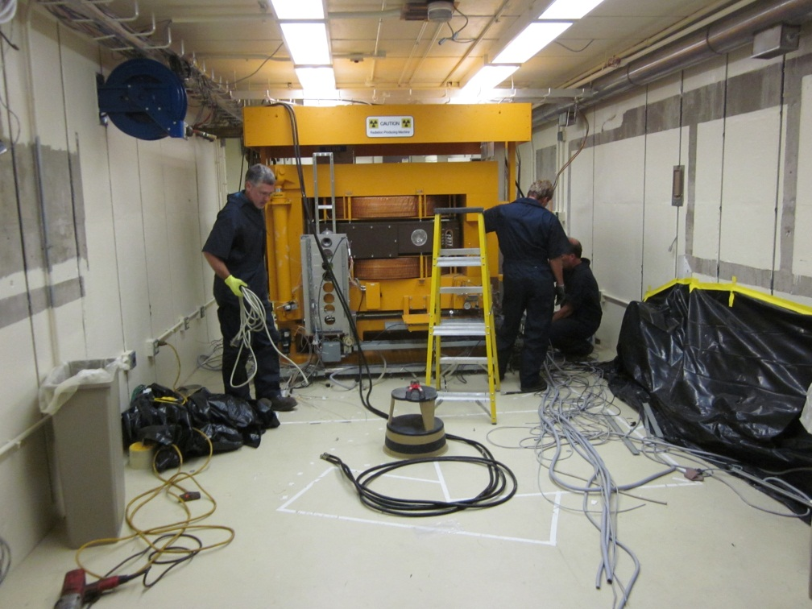
Package Ancillaries

Slide 12
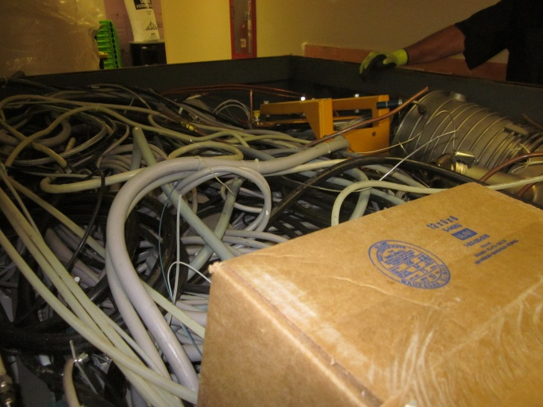
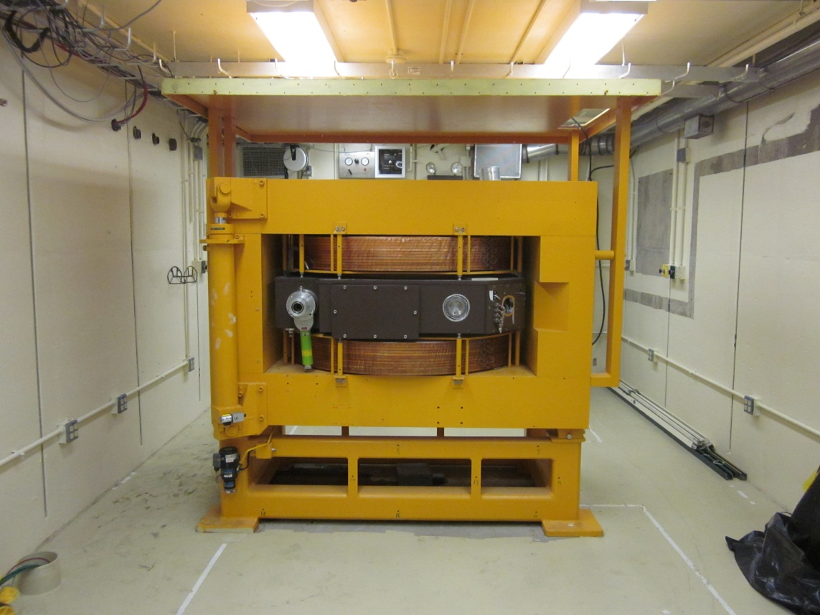
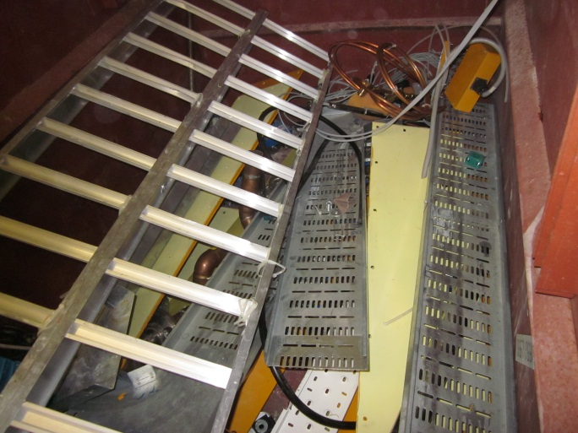
Package Ancillaries

Slide 13
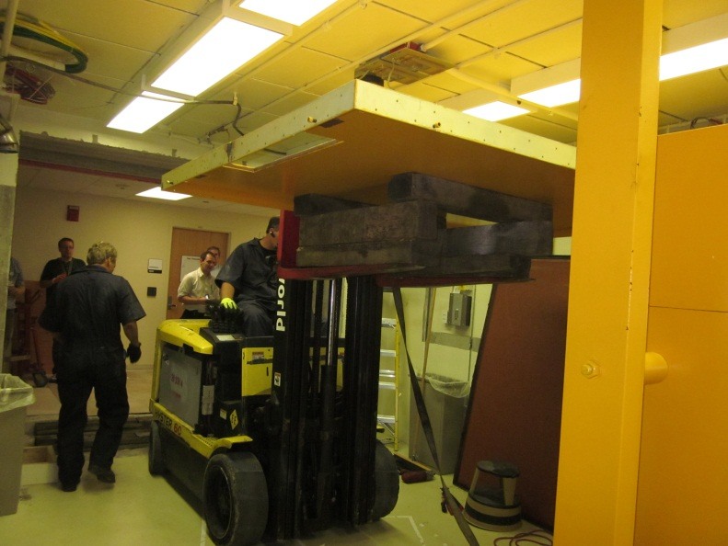
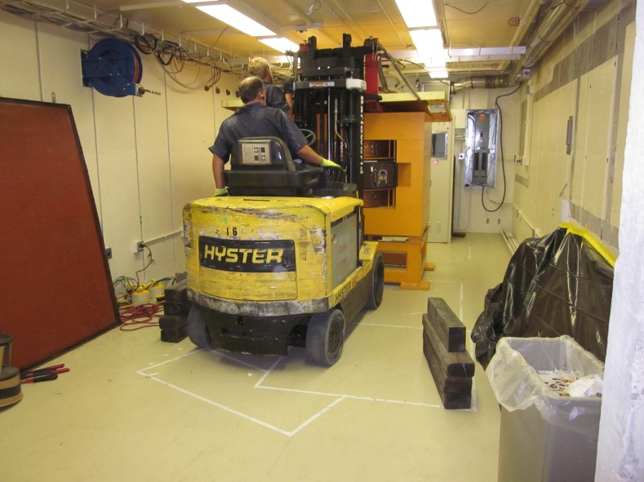
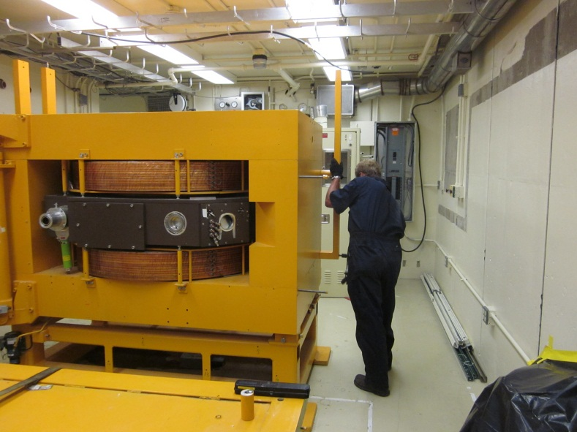
Remove RF Shield

Slide 14
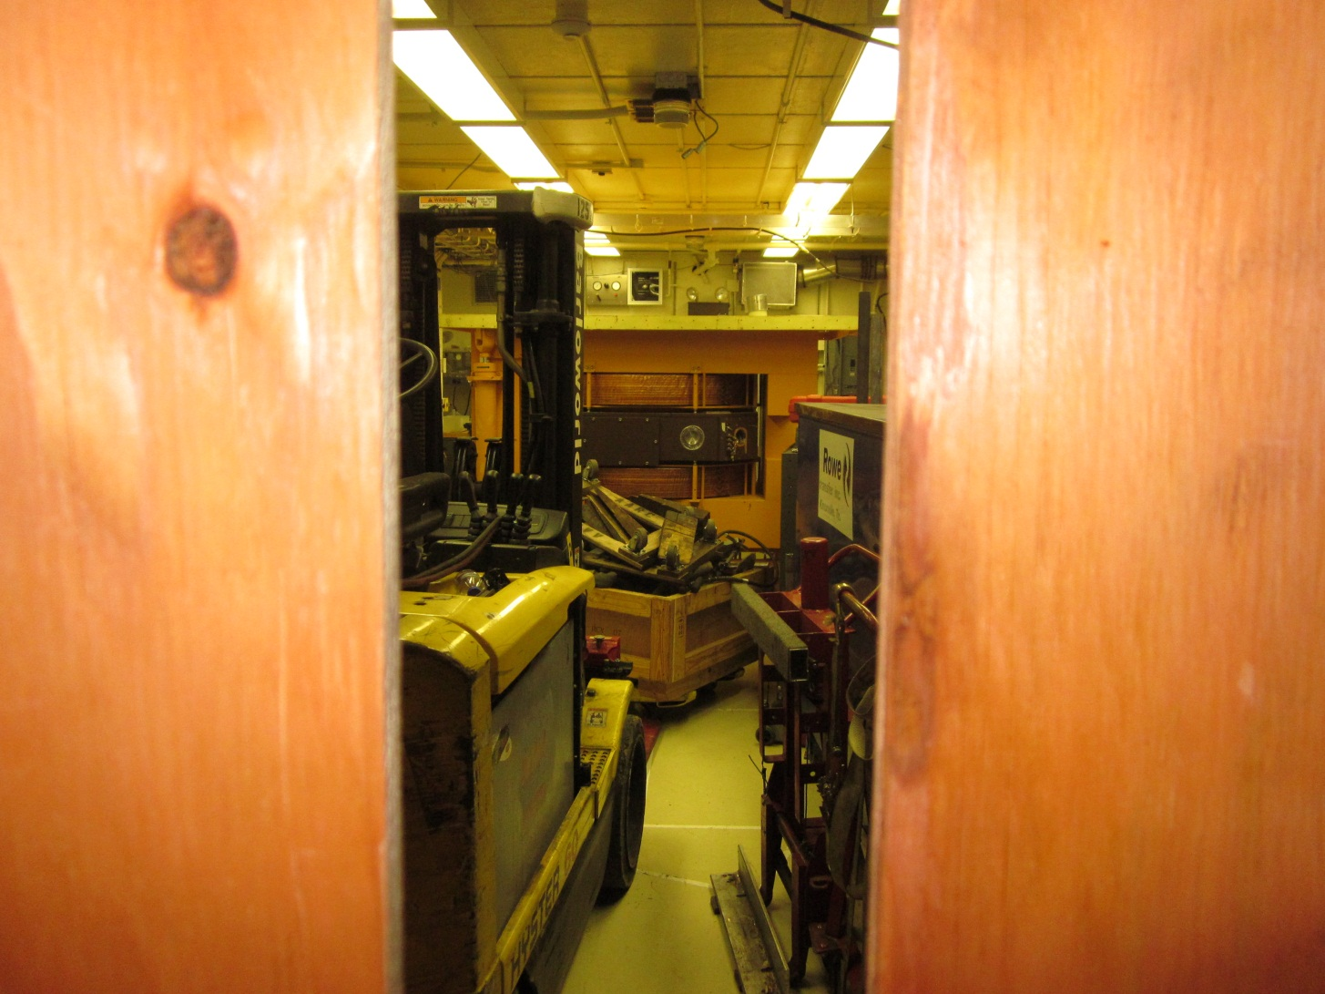
Material Handling

Slide 15
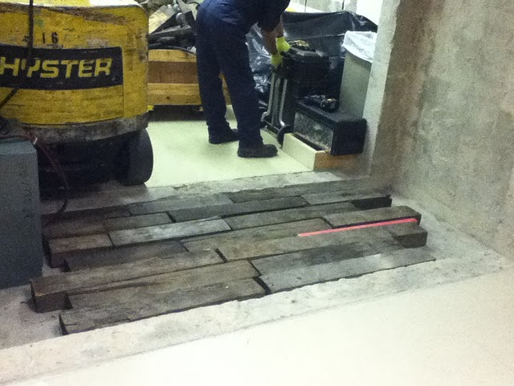
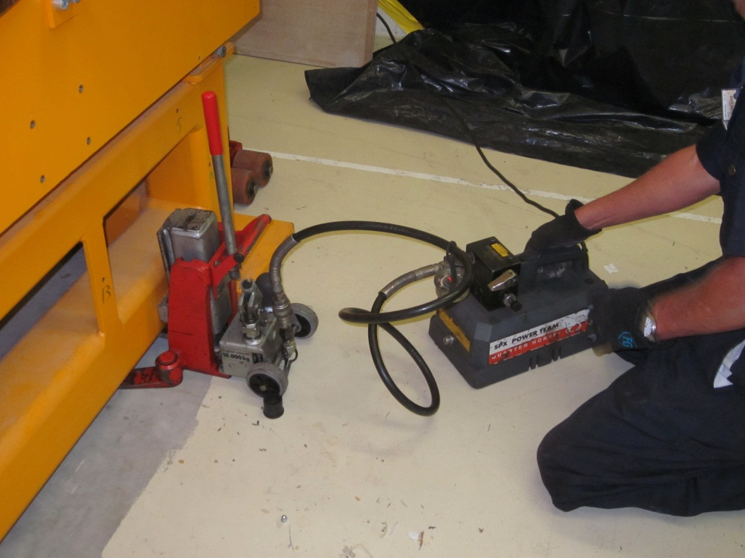
Material Handling

Slide 16
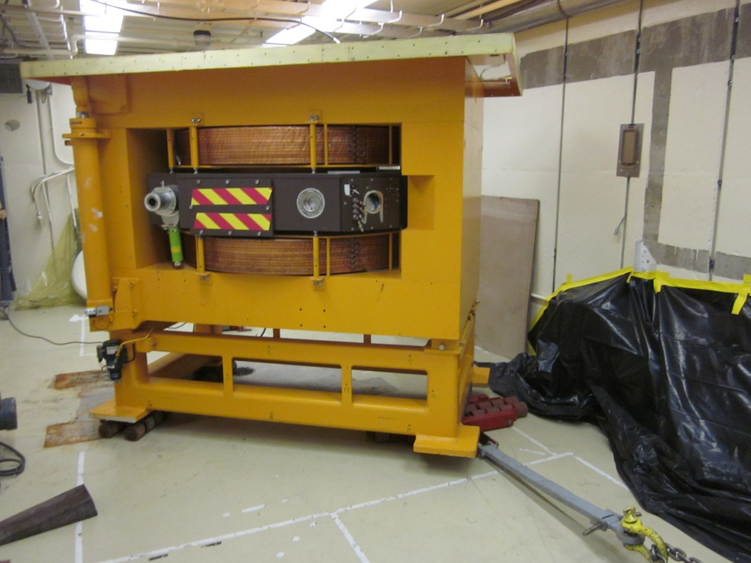
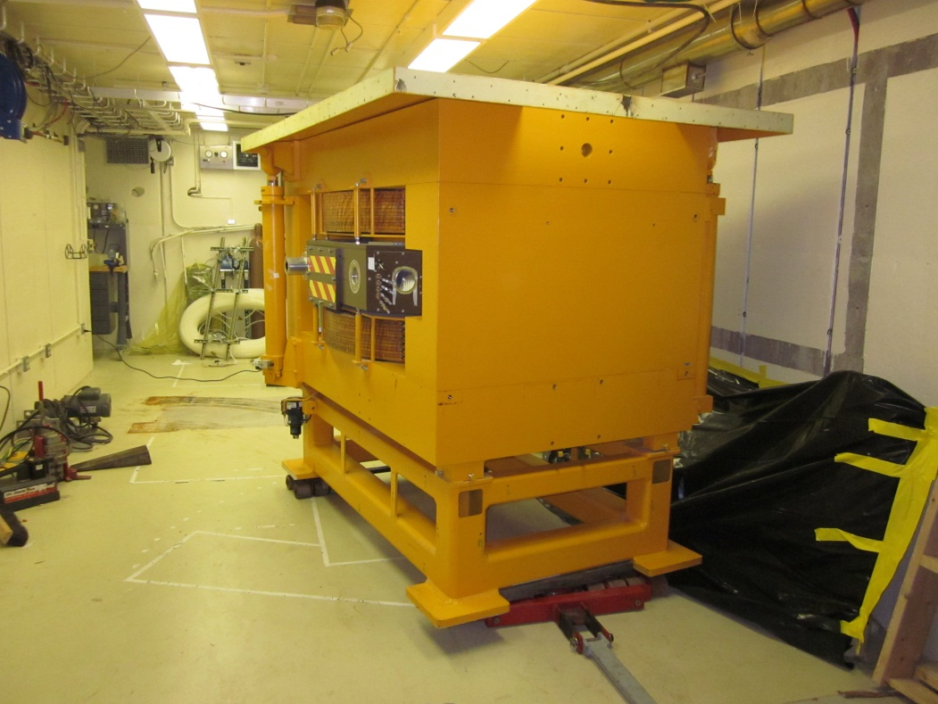
Material Handling

Slide 17
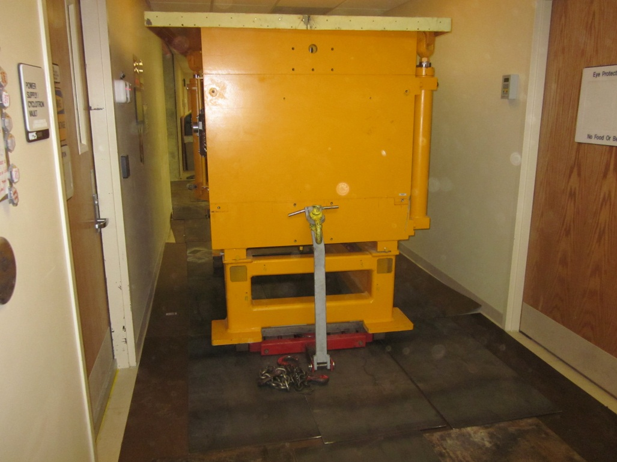
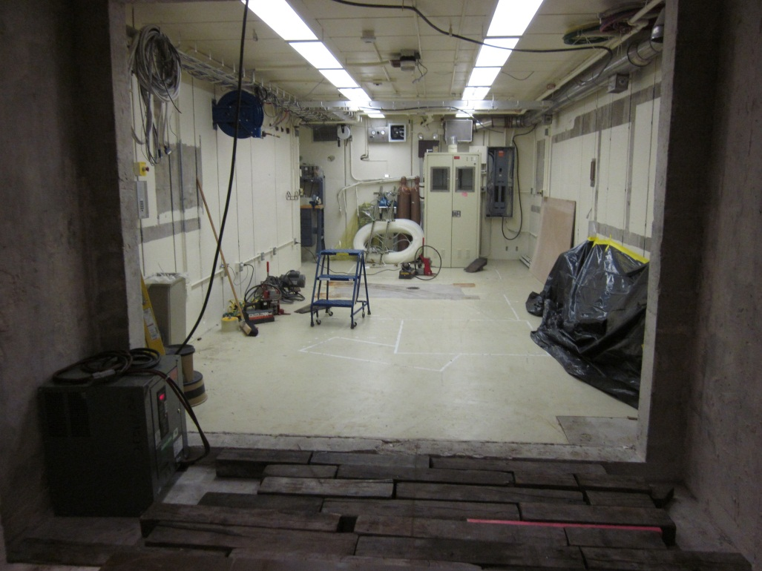
Material Handling

Slide 18
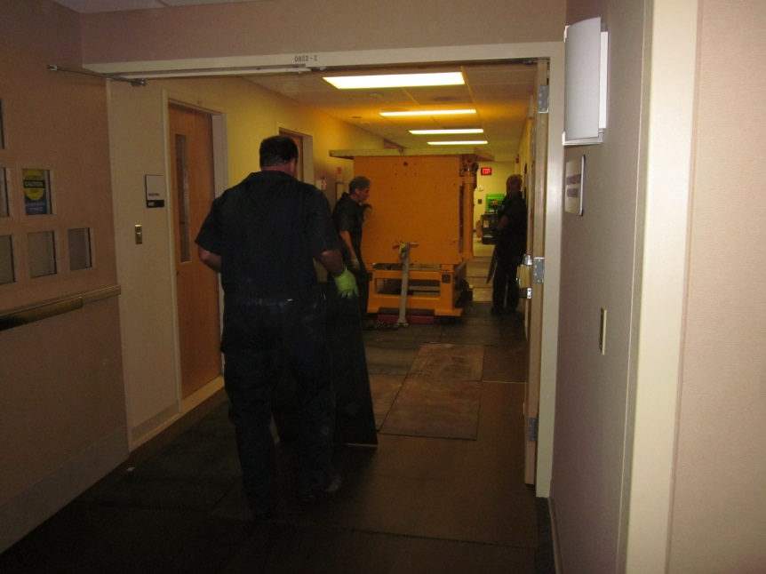
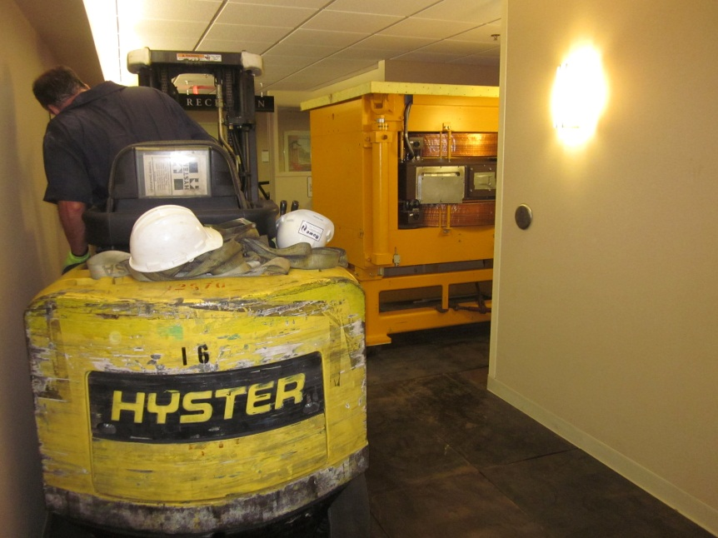
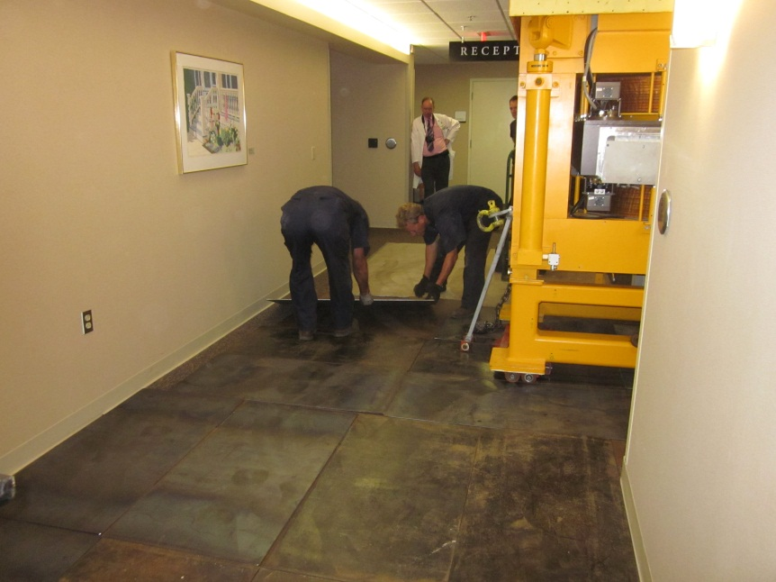
Material Handling

Slide 19
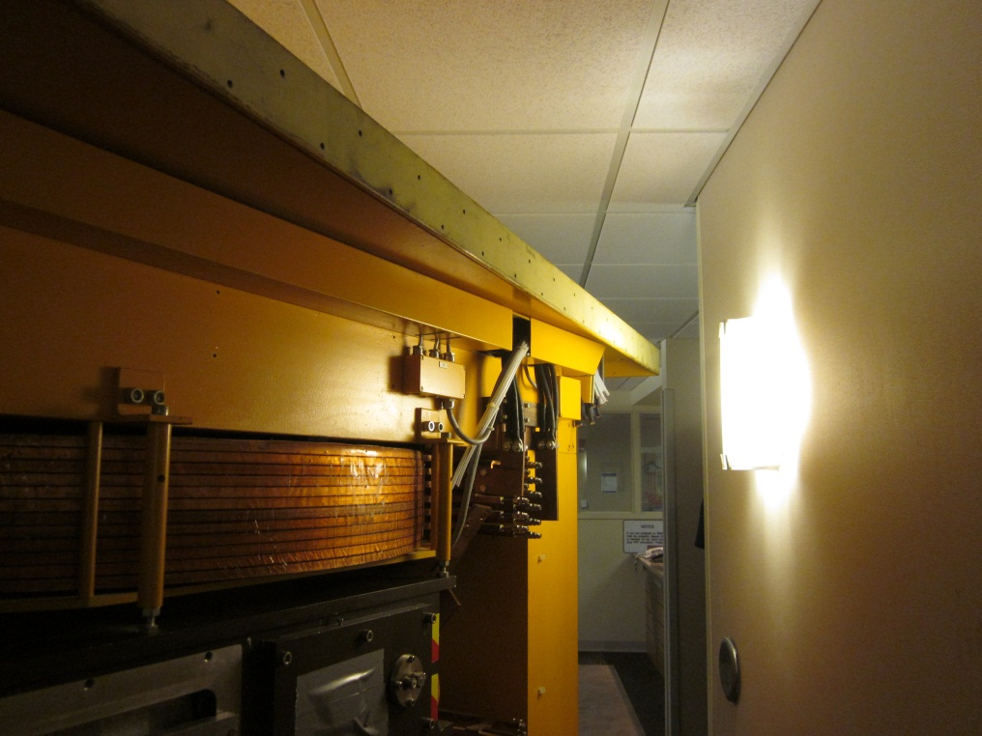
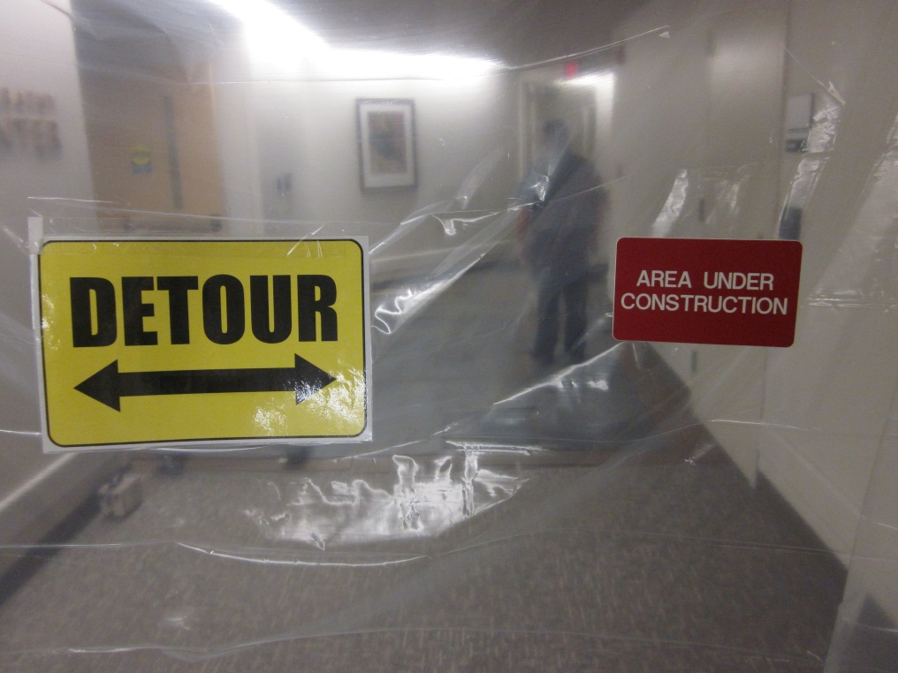
Material Handling

Slide 20
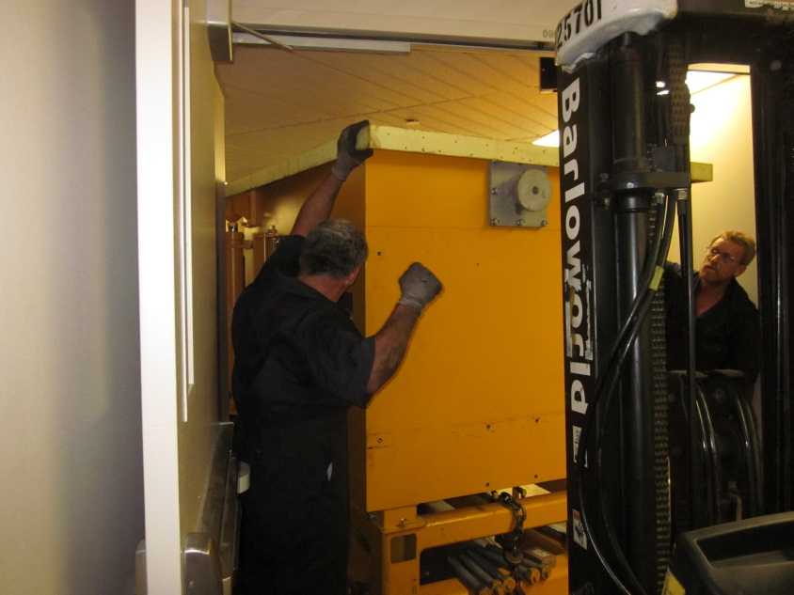
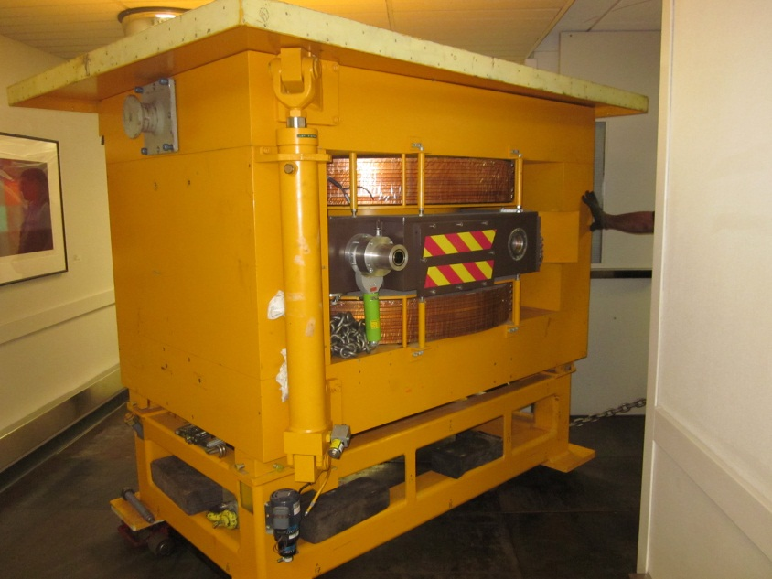
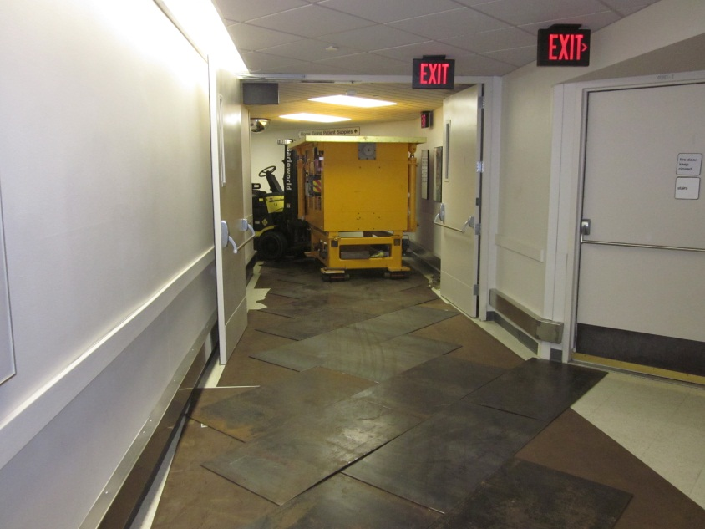
Material Handling

Slide 21
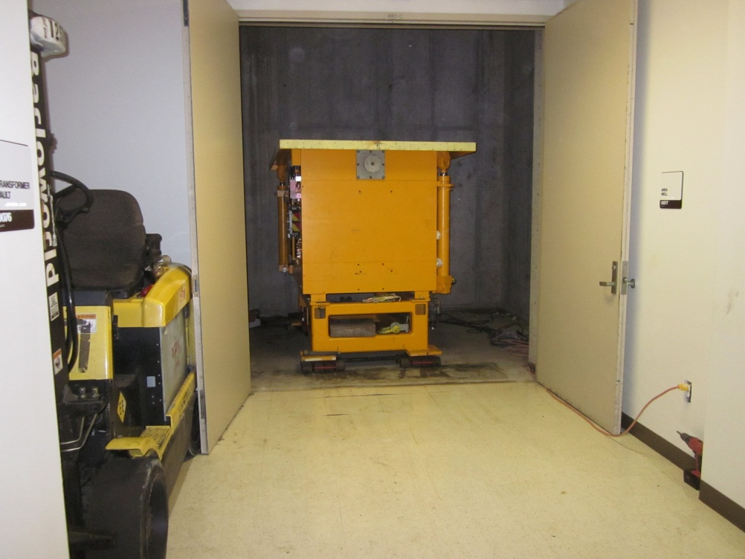
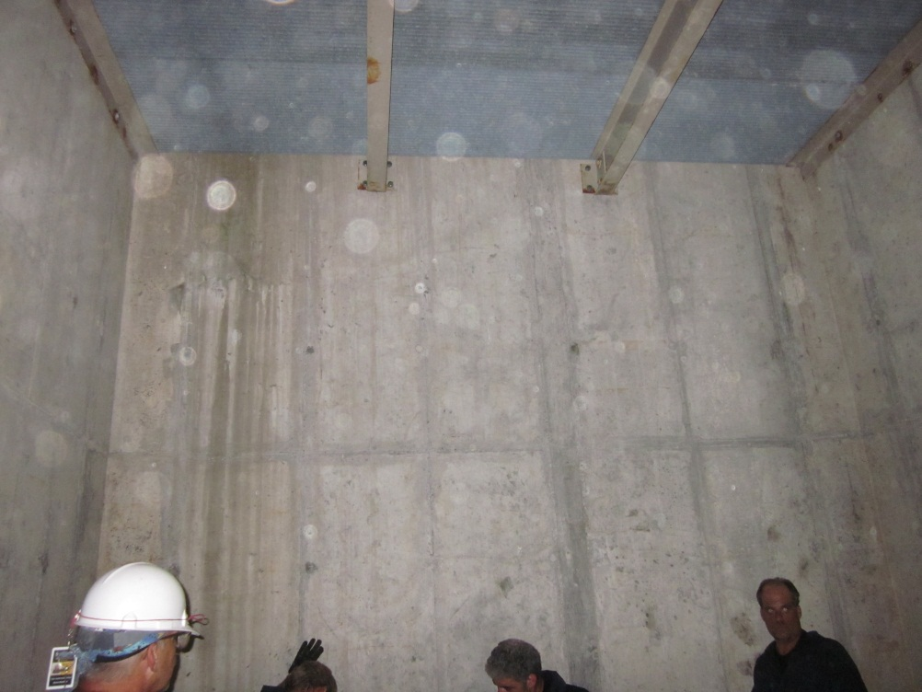
Material Handling

Slide 22
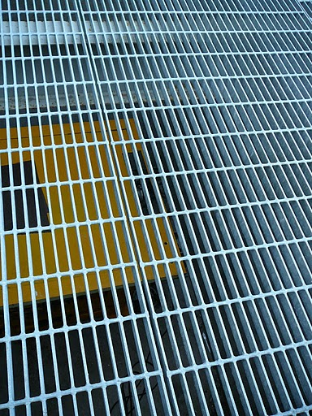
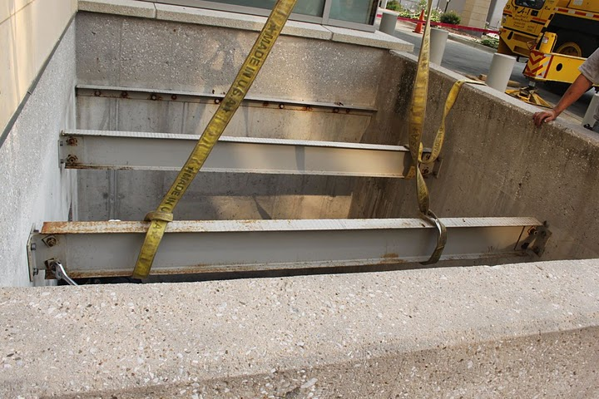
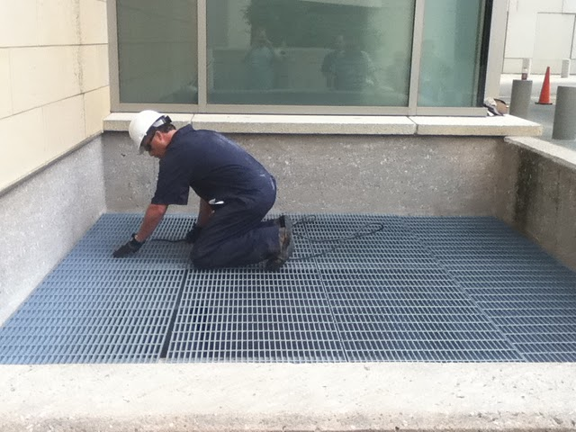
Material Handling

Slide 23
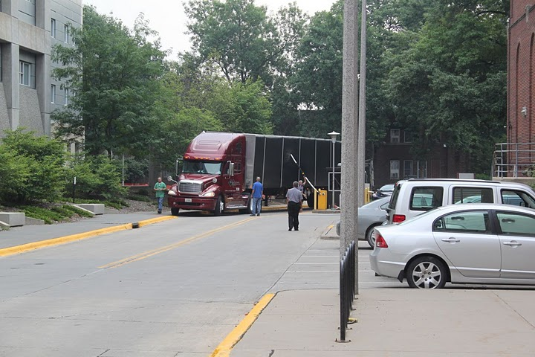
Loading and Shipping

Slide 24
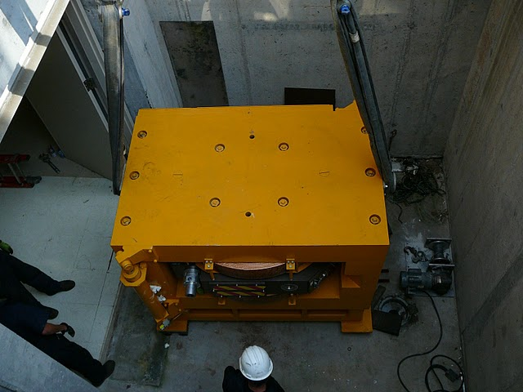
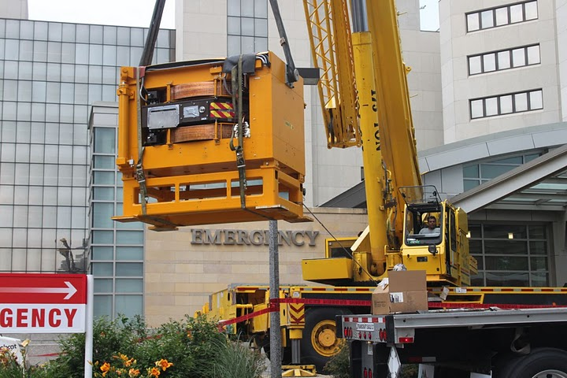
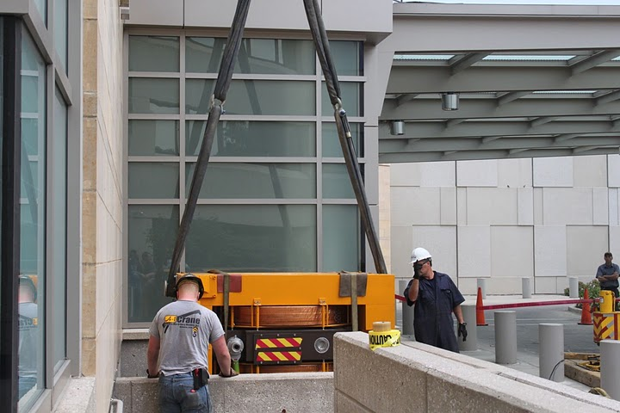
Loading and Shipping

Slide 25
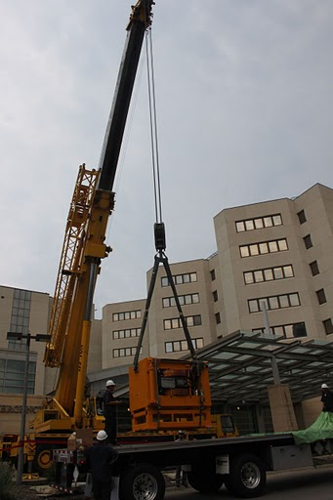
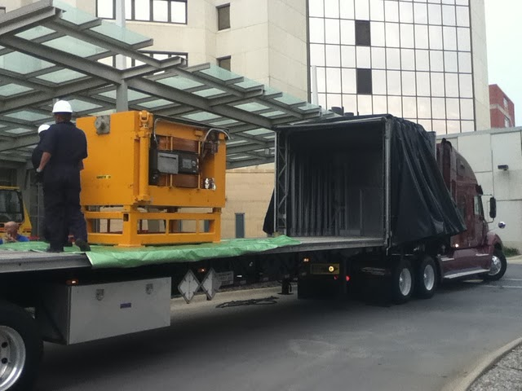
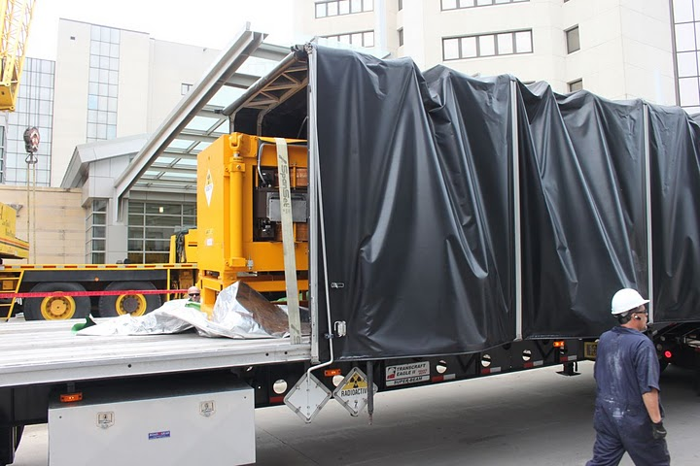
Loading and Shipping

Slide 26



Loading and Shipping

Slide 27
Project Metrics
LLRW shipped for disposal: 48,000 lbs.
Time: 324 person-hours over 3 day period
Cost: ~$200,000
Dose: 53 person-mrem (16 mrem max exposed individual)

